Slide 1
Motion Browser: Visualizing and Understanding Complex Upper Limb Movement Under Obstetrical Brachial Plexus Injuries
Gromit Yeuk-Yin Chan, Luis Gustavo Nonato, Alice Chu,
Preeti Raghavan, Viswanath Aluru, Claudio T. Silva
IEEE Transactions on Visualization and Computer Graphics, 2019

Slide 2


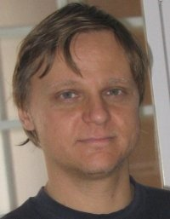
Gromit Yeuk-Yin CHAN, a PhD candidate studying Computer Science in
New York University.
Visualization and Data Analytics Laboratory (ViDA), 2016 - Present
HKUST Visualization Laboratory, 2015 - 2016
Visualization, Data Management
Claudio T. Silva, Tandon School of Engineering, New York University
Visualization, Graphics, Urban Computing, Geometry Processing, Scientific Data Management
Luis Gustavo Nonato, Instituto de Ciências Matemáticas e de Computação, Universidade de São Paulo
Visualization, Visual Analytics, Machine Learning, Data Science, Urban Data Science

Slide 3

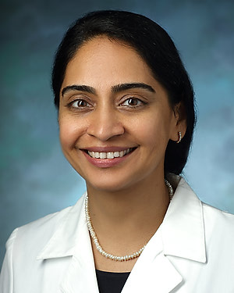
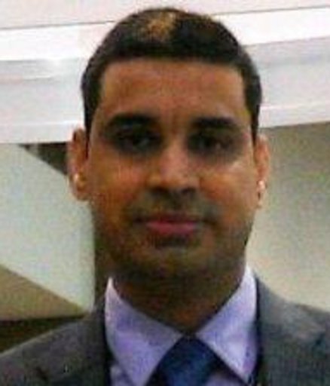

ALICE CHU, Associate Professor, Division Chief of Pediatric Orthopedics;
Rutgers New Jersey Medical School
Combined BA/MD from Rutgers New Jersey Medical School, 1995 - 2002
Hand and Upper Extremity Trauma, Neuromuscular Disorders, Pediatric Orthopaedics
Preeti Raghavan, Sheikh Khalifa Stroke Institute Endowed Chair
Associate Professor of Physical Medicine and Rehabilitation
Development of Novel Technology and New Treatments for Muscle Stiffness, Emotional Regulation and its Interaction with Recovery
Viswanath Aluru, University Of Illinois Hospital Health & Science Center

Slide 4
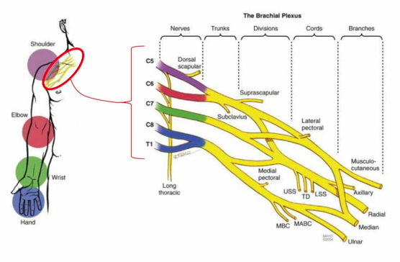
Introduction
Obstetrical Brachial Plexus Injuries

Slide 5
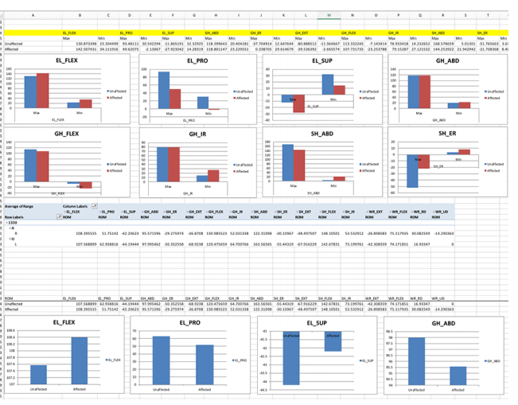
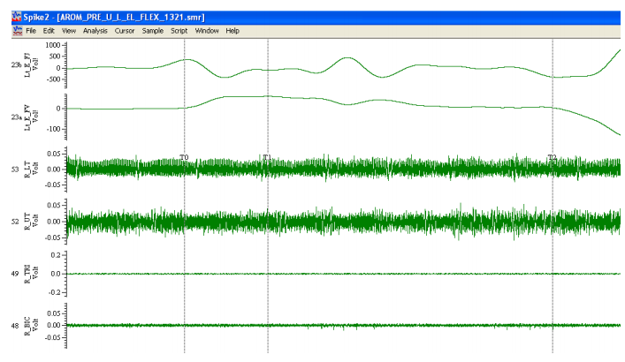
Introduction
Current Tools
(a)
(b)

Slide 6
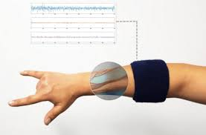
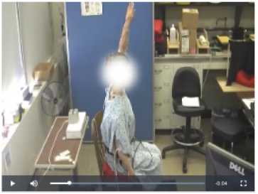
Introduction
Active Range of Motion Assessment
1
Electromyography(EMG) signals of muscle activations
3
Video recordings
2
Motion sensors recording limb displacement

Slide 7
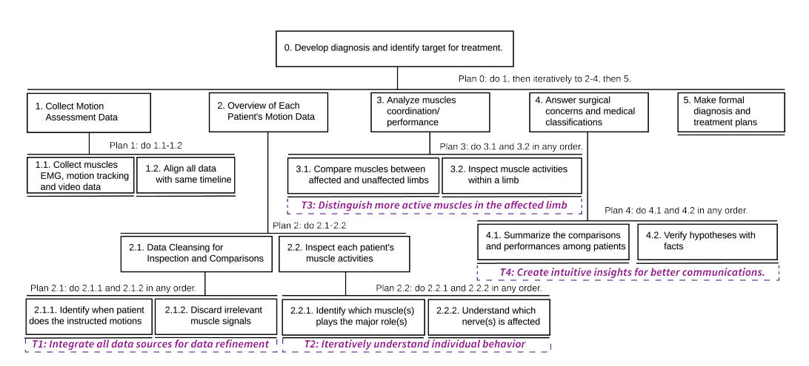
Task and Design
Task Abstraction

Slide 8
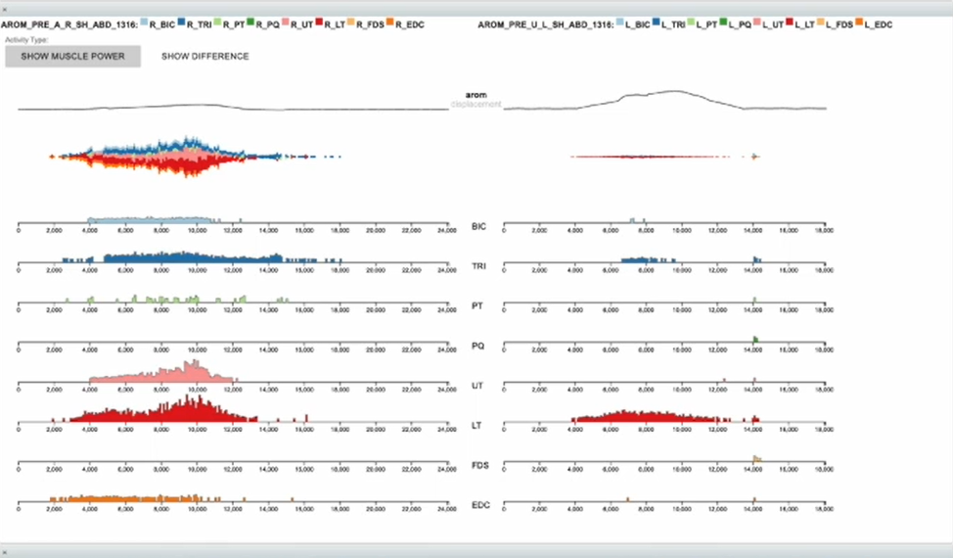
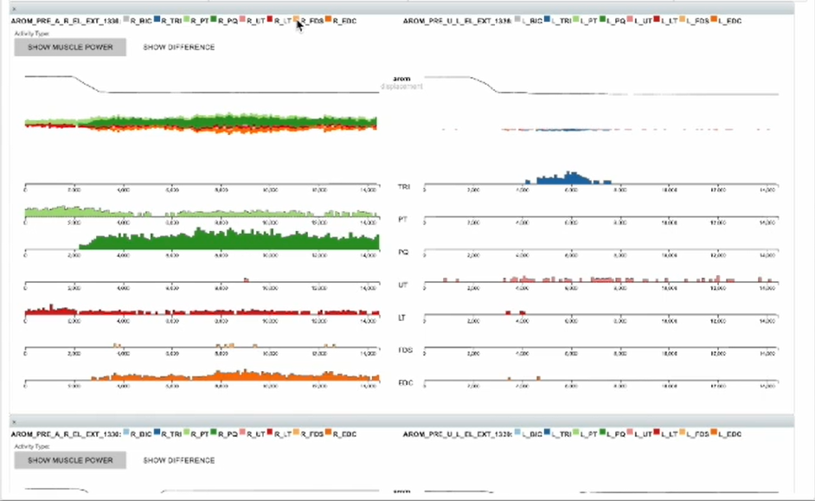
Task and Design
Task2: Overview of Each Patient's Motion Data
(a) Patient A
(b) Patient B
BIC, TRI （二头肌）
UT, LT ( 斜方肌 )
PT, PQ (旋前方肌)
FDS, EDC (屈指浅肌)

Slide 9
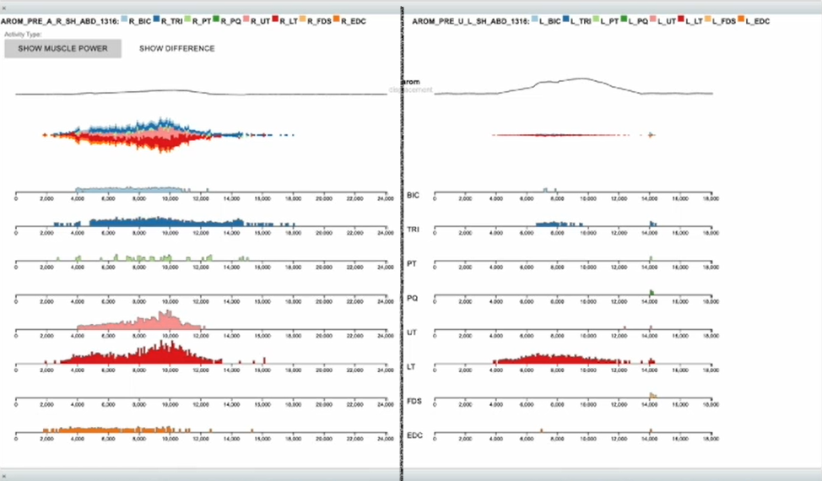
Task and Design
Task3: Analyze muscles coordination
Affected limb
Unaffected limb

Slide 10
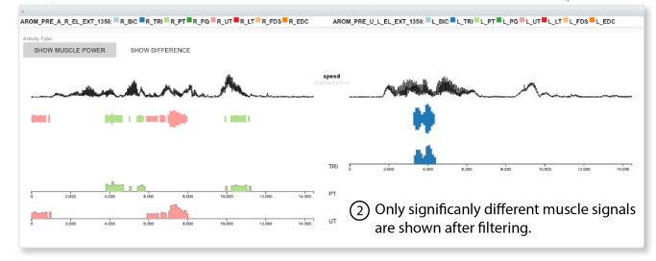
Task and Design
Task3: Analyze muscles coordination

Slide 11
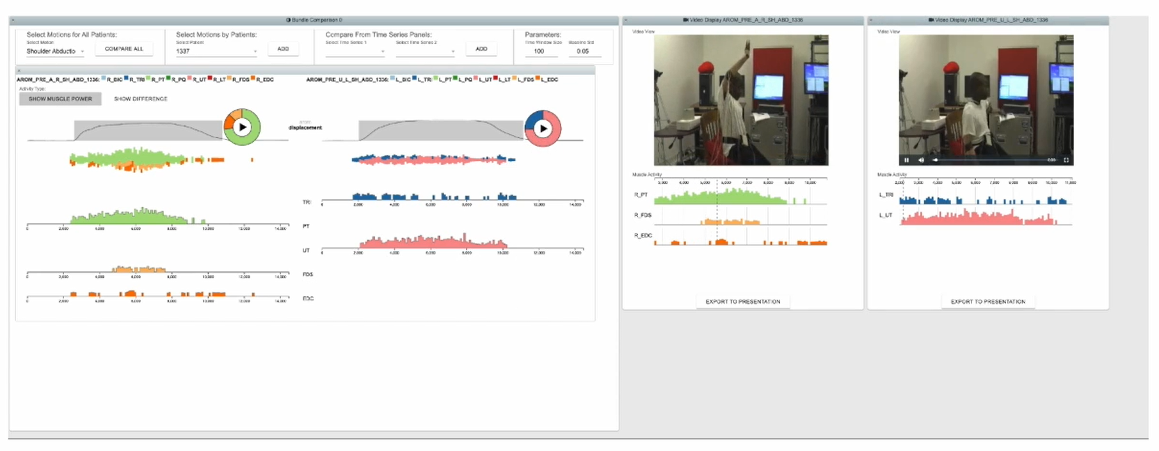
Task and Design
Task4: Verify hypotheses with facts

Slide 12
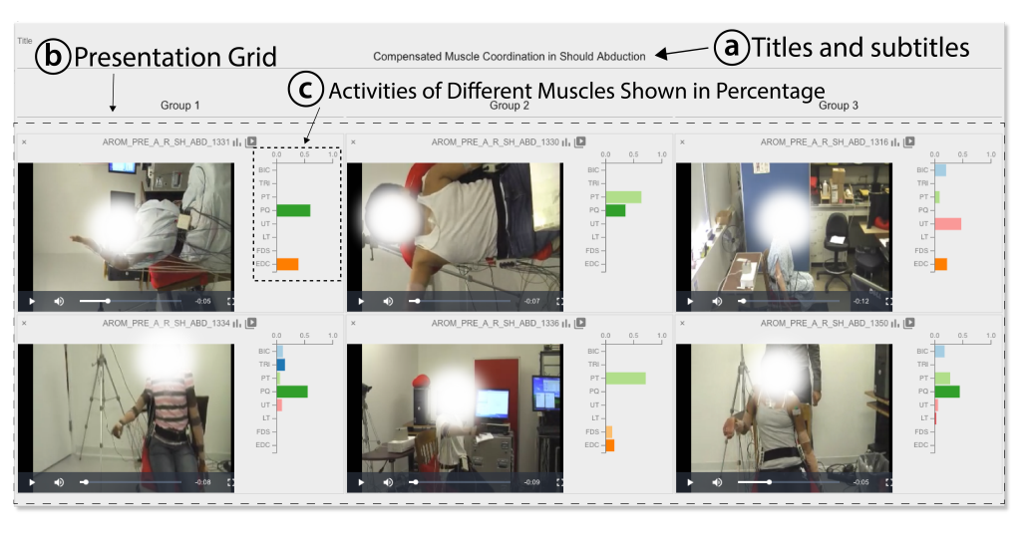
Task and Design
Task5: Summariza the comparisons among patients

Slide 13
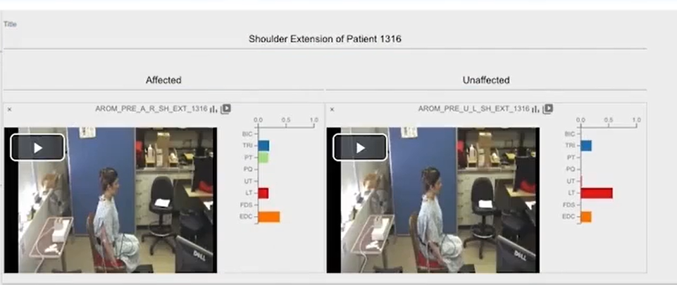
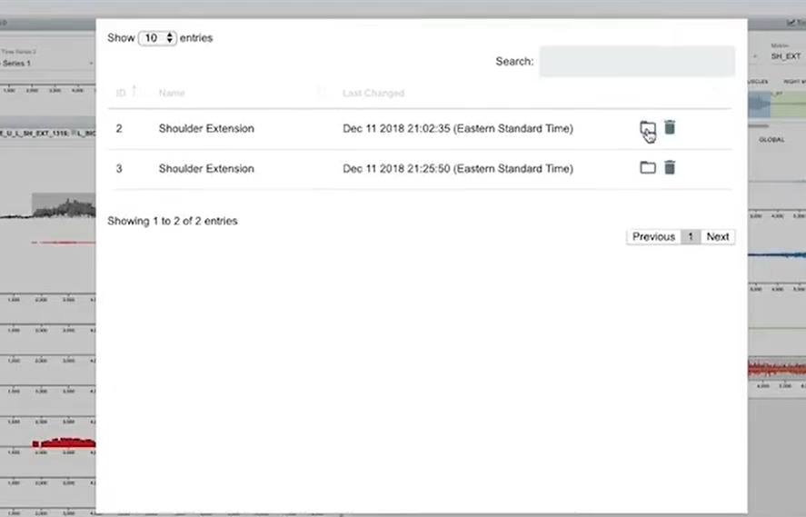
Task and Design
Task6: Better Communications

Slide 14
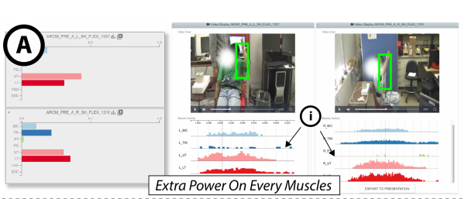
Case Study
Usefulness of Trapezius Muscles (pink and red) on Shoulder Motion

Slide 15
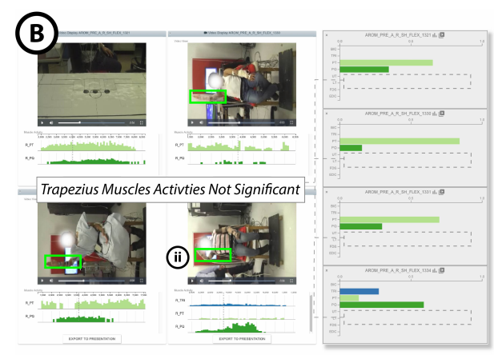
Case Study
Usefulness of Trapezius Muscles on Shoulder Motion
Patients not using trapezius muscles

Slide 16
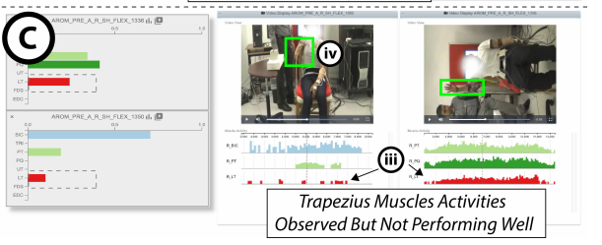
Case Study
Usefulness of Trapezius Muscles on Shoulder Motion
Patients using trapezius muscles

Slide 17
Pros
1. Shortening physicians' cycles of analyzing each patient.
2. It can be easily adapted for othersimilar problems, such as adult motion analysis or sports injury analysis.
Cons
1. It is unrealistic to attach hundreds of sensors to the patient.
2. Perception of noticeable differences between colored signals will diminish when there are more than 12 lines.

Slide 18
Thanks!

